Slide 3




Alberto Diaz Martin
ENCAMINA
Principal Team Leader
SharePoint Server MVP
http://geeks.ms/blogs/adiazmartin
http://blogs.encamina.com/negocios-sharepoint
@adiazcan

Slide 4
Office 365 y Azure Guía de desarrollo para maximizar tu nube

Slide 5
Developer vision
USERS
DATA
HTML

Slide 6
Setting Up Environments
Sign up for an Office 365 subscription (Trial or MSDN)
Create a Developer Site Collection
Create an App Catalog Site Collection
Sign up for Windows Azure subscription
Link Office 365 AAD to Windows Azure
Make Office 365 user administrator in Azure
Use Visual Studio remotely to develop

Slide 7
Developer Setup
Connecting Azure and Office 365

Slide 8
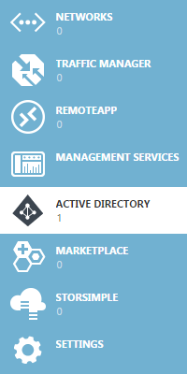
Azure Active Directory – Applications
What is it
3rd party applications can be registered in Azure Active Directory (the identity provider for Office 365) and granted access to data/capabilities in Office 365 and other registered applications
When to use it
Applications that need access to multiple Office 365 services
Stand-alone applications that need access to Office 365
Office 365 Examples
Mobile and Web applications that connect into Office 365

Slide 9
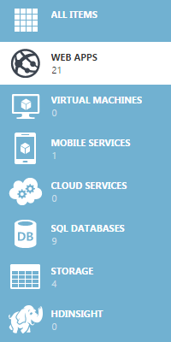
Azure Web Apps
What is it
Service for hosting websites and web apps across a number of platforms (.NET, NodeJS, PHP, Python, and Java) that are designed for enterprise grade workloads and offer global scale
When to use it
Applications that require a web user interface
Applications that host Web/REST/OData services
Office 365 Examples
Any stand-alone or contextual provider-hosted app
Services layer for a SharePoint-hosted app

Slide 10
Demo
Connecting Office 365 and Azure

Slide 11
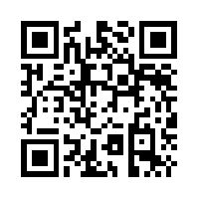
https://bit.ly/o365build

Slide 12
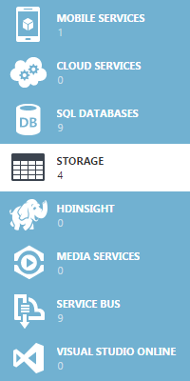
Azure Storage Queues
What is it
Queues provide an asynchronous location for message producers (sender) to drop off messages and message consumer (receiver) to pick up messages
When to use it
Communication between web and worker roles
Communication in hybrid solutions
Asynchronous communication without order guarantee*
Office 365 Examples
Site provisioning request/processing (including on-premises)
Mail merge for bulk emailing and document assembly

Slide 13
Demo
Azure Storage Queues

Slide 14
Azure Web Apps - Web Jobs
What is it
Component of Azure Web App that allows a background program or script to run on demand, continuously, or on a schedule
When to use it
Background or bulk processing
Scheduled, continuous, or triggered operations
Office 365 Examples
FTC Migration of SharePoint Timer Jobs into Office 365
Background Exchange processing (ex: Scheduling/Calendaring)

Slide 15
Demo
WebJobs

Slide 16
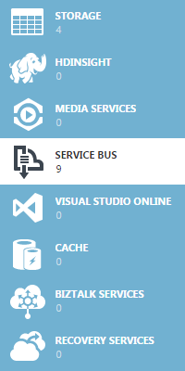
Azure Service Bus - Relays
What is it
A component of Azure Service Bus that provides bi-directional communication between two points by establishing outbound TCP connections to the Service Bus
When to use it
Secure communication to services/resources behind a corporate firewall and/or network address translation (NAT)
Application needs to leverage legacy resources on-premises
Office 365 Examples
Office 365 interoperability to legacy and/or on-premises LOB applications

Slide 17
Demo
Service Bus Relay

Slide 18
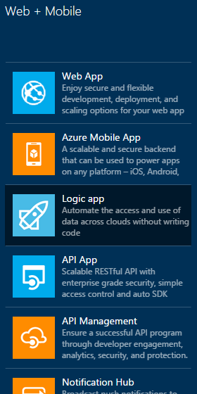
Azure Logic Apps
What is it
A fully managed Platform as a Service (PaaS) to automate business process execution and tricky integration scenarios via an easy to use visual designer
When to use it
Applications with connections that span a number of SaaS solutions (not all Office 365)
Applications that are workflow-based or rely on triggering logic
Office 365 Examples
SharePoint-based social posting manager
Site provisioning workflow that touches other SaaS offerings

Slide 19
Demo
Logic Apps

Slide 20
Q&A

Slide 21
Alberto Diaz Martin
ENCAMINA
Principal Team Leader
SharePoint Server MVP
http://geeks.ms/blogs/adiazmartin
http://blogs.encamina.com/negocios-sharepoint
@adiazcan

